Slide 1

CSE 350 Digital Electronics and Pulse Techniques
Prerequisite:
Electronic Devices and Circuits,
Digital Logic Design
Mail: shomen.kundu@bracu.ac.bd
Desk: #4N148 Course Instructor: Shomen Kundu (SDU)

Slide 2
Marks Distribution
Attendance : 2
Assignment : 5
Quiz : 18
Lab : 25
Midterm : 25
Final : 25
_____________________
Total : 100

Slide 3
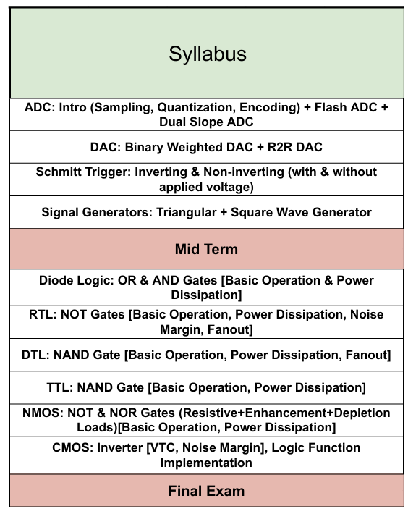
Syllabus ( Fall 25 )

Slide 4
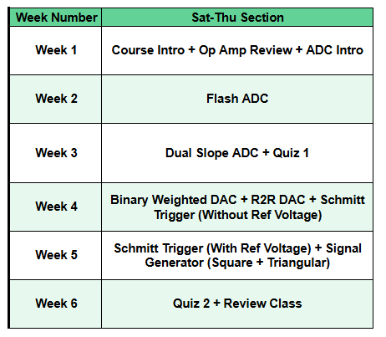
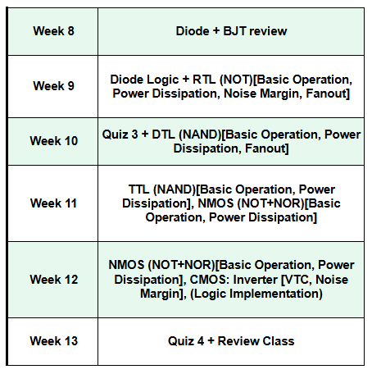
Timeline

Slide 5
Review ( Circuits and Electronics )
Ohm’s law
KCL
KVL
Node Analysis

Slide 6
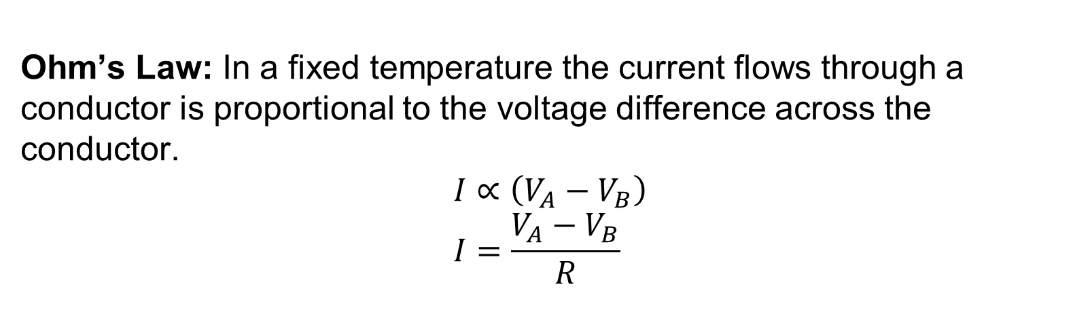
Review ( Circuits and Electronics )
Ohm’s Law: In a fixed temperature the current flows through a conductor is proportional to the voltage difference across the conductor.
$$I∝\left(V_{A}−V_{B}\right) \\ I=\frac{V_{A}−V_{B}}{R}$$
V_{A} > V_{B}
V_{A}
V_{B}
_{I}

Slide 7
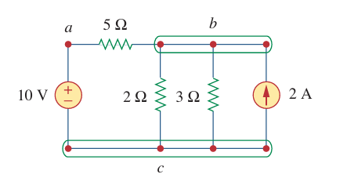
Review ( Circuits and Electronics )
Node : Interconnected points between two and more electrical component.

Slide 8
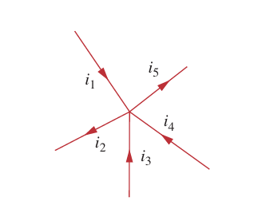
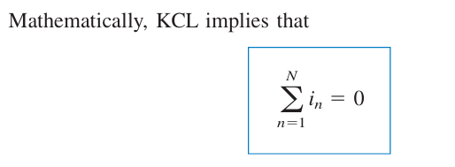
Review ( Circuits and Electronics )
Kirchhoff’s current law (KCL): states that the algebraic sum of currents entering a node (or a closed boundary) is zero.
Convention: a. Current Entering a node is positive
b. Current Exiting a node positive

Slide 9
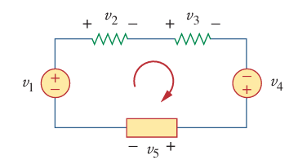
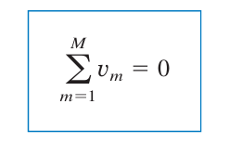
Review ( Circuits and Electronics )
Kirchhoff’s voltage law (KVL) states that the algebraic sum of all volt ages around a closed path (or loop) is zero.

Slide 10
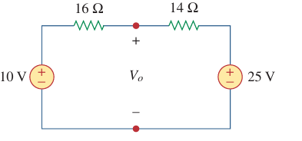
Review ( Circuits and Electronics )
Example: Find the value of I for the below circuit.
i

Slide 11
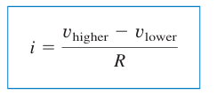
Review ( Circuits and Electronics )
Node Analysis: Goal -> Finding “node voltage”
Techniques -> KCL and Ohm’s Law
Step:
Identify reference voltage
Identify unknown node voltage
Write the node equation
Solve the node equation

Slide 12
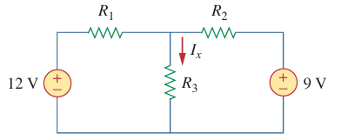

Review ( Circuits and Electronics )
Example: Find the voltage of the node a. Given $R_{1}=10Ω$, $R_{2}=5Ω$and $R_{3}=20Ω$.
a

Slide 13
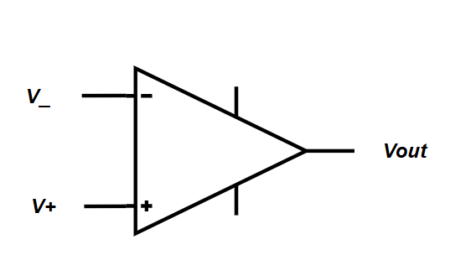



Op-Amp Review
Important terminals of Op-Amp
$V_{+}$→ Non-Inverting ( Positive ) input terminal
$V_{−}$→ Inverting ( Negative ) input terminal
$V_{H}$→ Higher power supply terminal
$V_{L}$→ Lower power supply terminal
$V_{out}$→ Output terminal
$$V_{H}$$
$$V_{L}$$

Slide 14
Op-Amp Review
Operational Amplifier can be used for different configurations
Open Loop → Comparator, Used in ADC
Negative Feedback →Amplifier, Used in DAC
Positive Feedback → Signal generator, Schmitt Trigger

Slide 15



Op-Amp Review
For open loop configuration
$$If V_{+}>V_{−} , V_{out}=High (V_{H})$$
$$If V_{+}<V_{−} , V_{out}=Low (V_{L} )$$
For ideal Op-Amp
$$I_{−}=0 and I_{+}=0$$
$$V_{H}$$
$$V_{L}$$

